Slide 1

Quick Sort, Quick 3-Way, MinPQ Sorting Algorithms
IT- 516 Data Structures & Algorithms
Red Team
06 – 14 – 2023
Prof. Sean Harrington
Reddy Balaji Madha
Anthony Evangelista

Slide 2


Agenda
Introduction
Quick Sort
Quick 3-Way
MinPQ

Slide 3

Introduction
What is sorting, and why do we do it?
Humans have a natural inclination to categorize and arrange things in ascending or descending order. We find satisfaction in creating a systematic structure and arranging items based on their increasing or decreasing values.
Let's Say you walk into a kitchen you would find drawer set aside for utensils; drawer set aside for utensils and another shelf for glasses and so on.
And now let's Say you go to a library, there are very high chances that you find all the books categorized by the genres and organized in Alphabetical order.
Why do we organize things ?
Sorting is important because it offers visual appeal and simplifies the process of searching for specific items. When things are organized, it creates an aesthetically pleasing arrangement, and when we need to find something, it becomes much easier compared to searching through random or unorganized items.
Just like humans, computers also need to organize their data to store and retrieve it efficiently. Sorting data helps computers store information in an orderly manner, making it easier and faster to find what they need.

Slide 4

Time and space complexity
There are different kinds sorting algorithms, how to we find which is the best ?
When comparing sorting algorithms, it's not enough to focus only on speed. Each algorithm has its own purpose and is used in specific situations.
Time Complexity: Time Complexity is defined as the number of times a particular instruction set is executed rather than the total time taken. It is because the total time took also depends on some external factors like the compiler used, processor’s speed, etc.
Space Complexity: Space Complexity is the total memory space required by the program for its execution.
Both are calculated as the function of input size(n).

Slide 5
Big O notation
Big O notation is used to describe the performance or complexity of an algorithm by providing an upper bound on its growth rate. It represents the worst-case scenario for the algorithm's time or space requirements as the input size increases.
Bubble sort.
Big O notation of Bubble sort is - O(n^2)

Slide 6
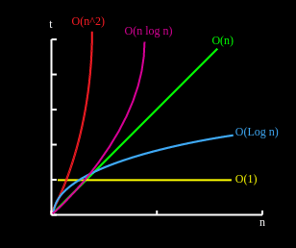
Big O notation
O(1)
O(log n)
O(n)
O(n log n)
O(n^2)

Slide 7

Quick Sort
Quicksort is widely considered to be the fastest general-purpose sorting algorithm available. It works by selecting a pivot element from the data set and partitioning the remaining elements around it.
The process is repeated recursively on the left and right partitions until the entire data set is sorted.
Quicksort has an average time complexity of O(n log n) and a worst-case time complexity of O(n^2).
And quick sort uses the divide and conquer methodology

Slide 8
Quick Sort
Let's take an example array of random array = [19, 7, 15, 12, 16, 18, 4, 11,13]
19
7
15
12
16
18
4
11
13
Here we took the 13 as Pivot
7
12
4
11
13
18
15
19
16
11
16
15
18
19
7
4
12
4
7
18
19
4
7
11
12
15
16
18
19

Slide 9

Runtime Complexity
Best-case run time : If you select the mean element as the pivot, you are considered to have the best case for quicksort. O(n log n).
Average-case run time: It is believed that quicksort is slower than average when we do not receive evenly balanced partitions, with an O(n log) time complexity.,
Worst case run time : In terms of the worst case of quicksort, it occurs when either the smallest or largest element in the list is selected as the pivot element or If the input list is nearly sorted and the partitioning consistently creates imbalanced partitions, the time complexity of QuickSort can degrade to O(n^2) instead of its average-case time complexity of O(n log n).

Slide 10

advantages and disadvantages of quick sort
Advantages
Fast and efficient
Simple Implementation
Time complexity
Disadvantages of quicksort
Unstable
Vulnerable to Malicious Input
Recursive Nature

Slide 11
Quick 3-Way
The Quick 3-Way Algorithm is a variation of QuickSort that is designed to handle duplicate keys more efficiently. Instead of partitioning the data set into two parts, the Quick 3-Way Algorithm partitions it into three parts.
The left partition contains elements less than the pivot, the middle partition contains elements equal to the pivot, and the right partition contains elements greater than the pivot. This allows for faster sorting of data sets with many duplicate keys.

Slide 12
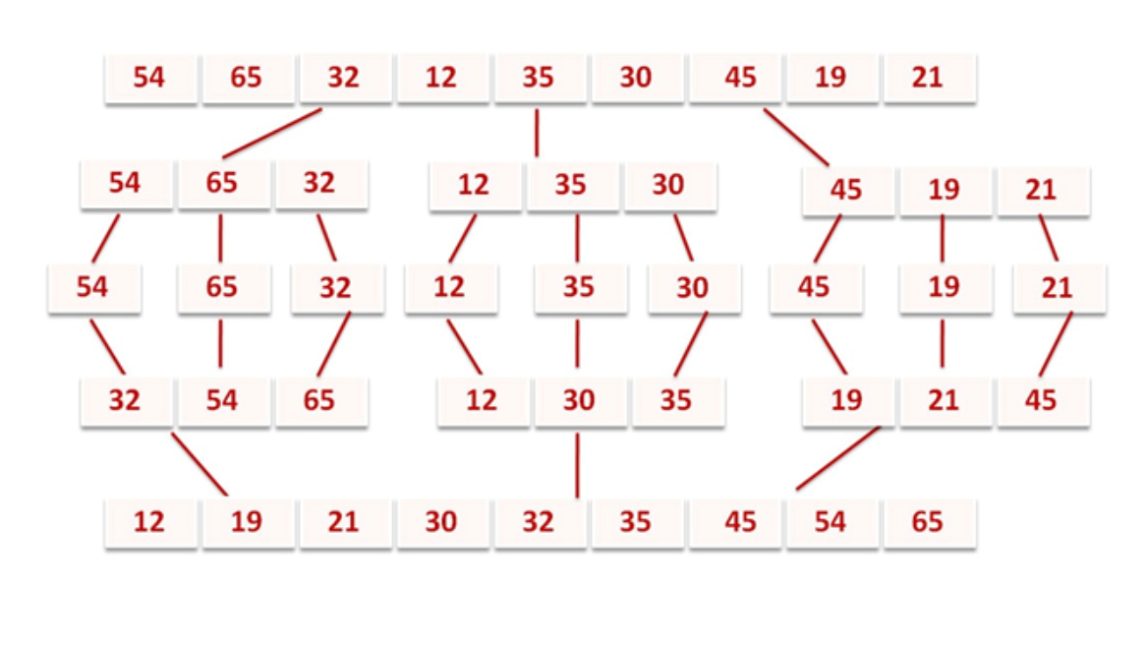
Quick 3-Way
Let's take an example array of random array = [54, 65, 32, 12, 35, 30, 45,19,21]

Slide 13
Time complexity
Quick Sort:
Average Case: O(n log n)
Best Case: O(n log n)
Worst Case: O(n^2)
Quick 3-Way Sort:
Average Case: O(n log n) (improved compared to Quick Sort in scenarios with many duplicates)
Best Case: O(n) (improved compared to Quick Sort in scenarios with many duplicates)
Worst Case: O(n^2) (same as Quick Sort in scenarios where all elements are equal)

Slide 14
Advantages and Disadvantages of Quick 3-Way Sort:
Advantages
Efficient for Duplicate Values
Improved Time Complexity
Stability
Disadvantages
Additional Overhead
Space Complexity
Complexity in Implementation

Slide 15
MInPQ
A priority queue is a data structure that allows us to maintain a set of items with priorities. The MinPQ algorithm is a sorting algorithm that uses a priority queue to sort elements in ascending order.
The algorithm works by inserting all elements into the priority queue, then repeatedly removing the smallest element and adding it to the sorted list until the priority queue is empty. MinPQ has a time complexity of O(n log n).

Slide 16
MInPQ
Purpose: Efficient retrieval and processing of elements in priority order
Applications: Task scheduling, event handling, resource allocation
Criteria for Priority: Numeric values, timestamps, custom comparison functions

Slide 17
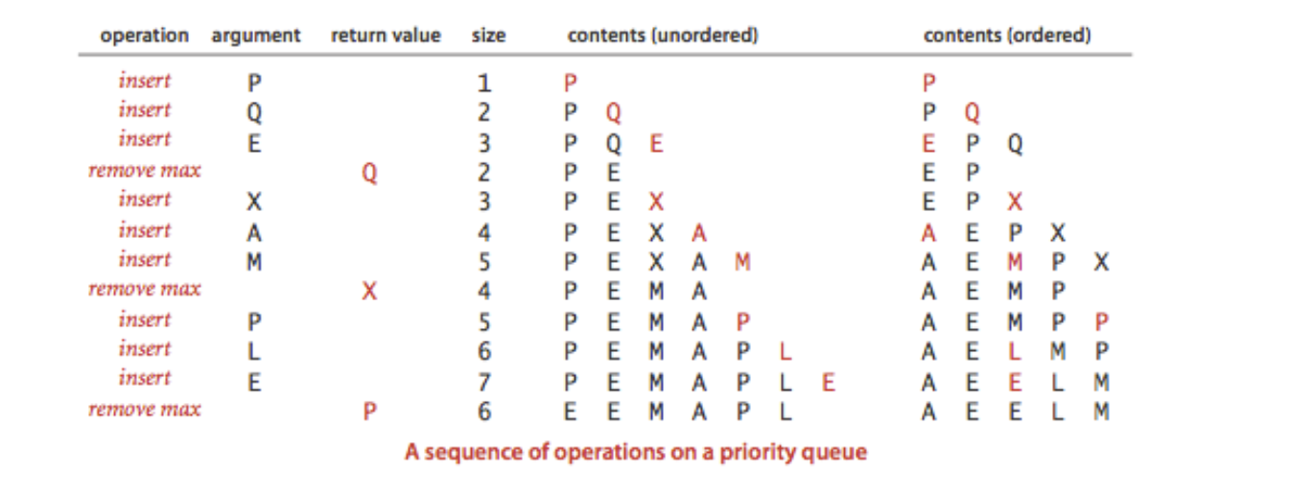
MInPQ

Slide 18
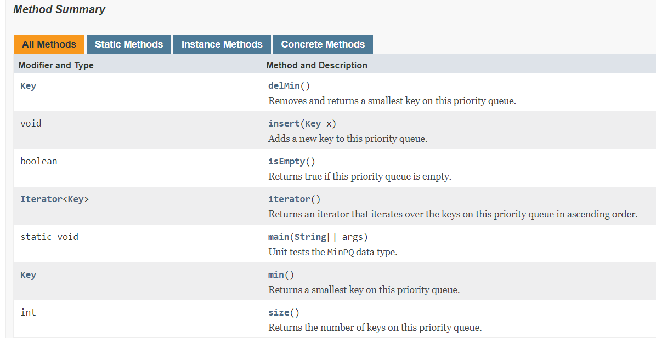
MInPQ

Slide 19
Advantages and Disadvantages of Minpq
Advantages:
Efficient Minimum Retrieval
Sorting
Efficient for Large Datasets
Disadvantages:
Not Stable
Additional Space Required

Slide 20

References
M., & M. (2023, June 16). Advantages and Disadvantages of Quick Sort. Retrieved from https://yovak.com/advantages-and-disadvantages-of-quick-sort/
QuickSort Data Structure and Algorithm Tutorials. (2023, May 30). Retrieved from https://www.geeksforgeeks.org/quick-sort/
Mohandas, A. (2021, December 24). Three Way Partitioning. Retrieved from https://iq.opengenus.org/three-way-partitioning/
3 way Merge Sort. (n.d.). Retrieved from https://www.mycareerwise.com/programming/category/sorting/3-way-merge-sort

Slide 21


Summer 2023 Prof. Sean Harrington
THANK YOU
Reddy Balaji Madha
Anthony Evangelista
rmadha@callutheran.edu
aevangelista@callutheran.edu

